Slide 1
Political Science
Team IG:
Qi, Xinci, Yiru, Shicheng
12/06/2019

Slide 2
Recap last presentation
Concerns on the old data
No significant relationship between vocational education and union density
Adding Racial Diversity helps a little in explaining the relationship between vocational education and union density, but we do not have a conclusive information here

Slide 3
What we have done
Data check
Linear regression on year 2010 (Racial Diversity)
Model improvement and transformation
Linear regression on year 2009 to 2017 (Racial Diversity)
Model improvement and transformation
Linear regression on student population as required
Mediation analysis on all models
Exclude leverage points of GDP Per Capita (DC)
Exclude Urbanity

Slide 4
New Data Description
Outcome: Vocational Education
Predictor: Union Density
Confounding Variables: Year (2009 to 2017), Urbanity, Unemployment, GDP Per Capita, Racial Diversity, Total Population/Student Population
Other concerns
Urbanity (2010)
Notes:
why we use GDP per capita instead of the proportion of GDP

Slide 5
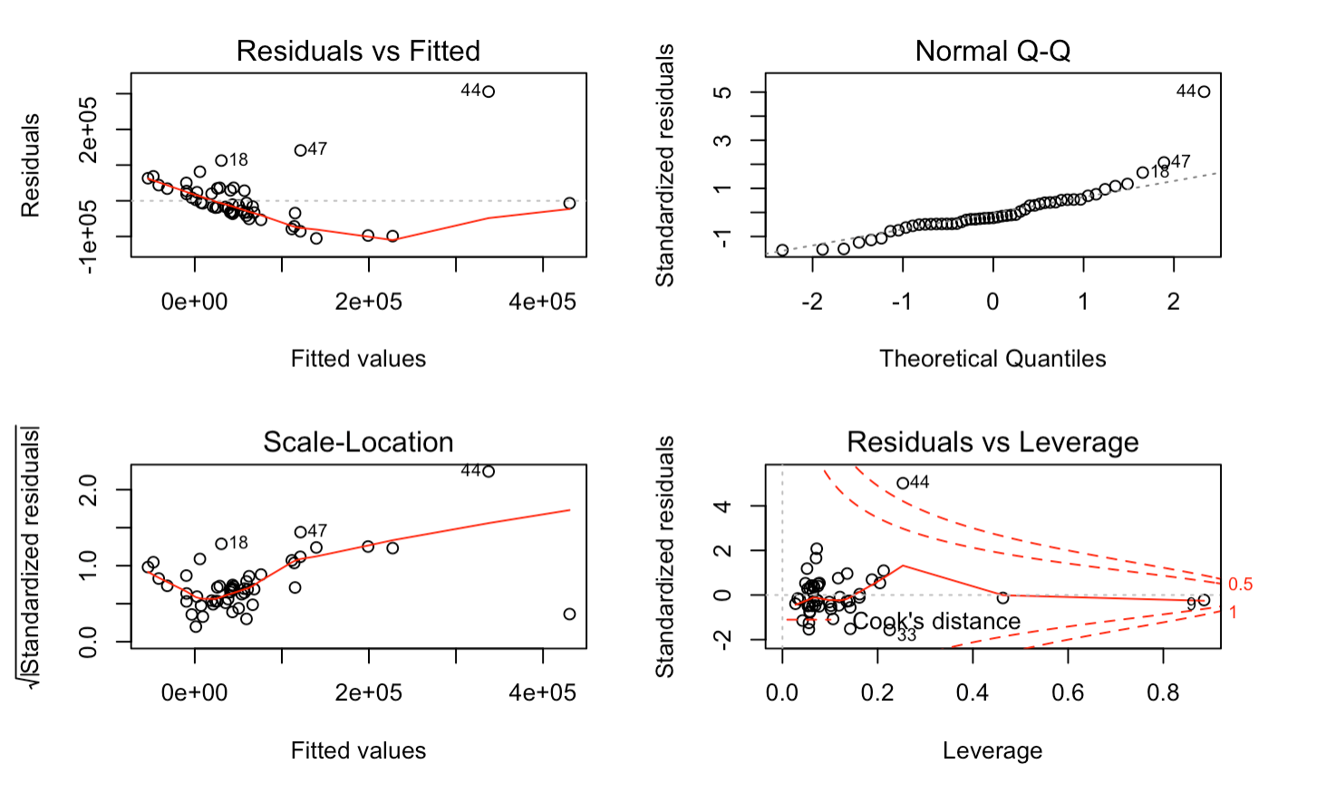
Model1: Linear Model on year 2010
Outcome: Vocational Education
Predictor: Union density
Confounding variables: Urbanity, Unemployment, GDP Per Capita, Total Population

Slide 6
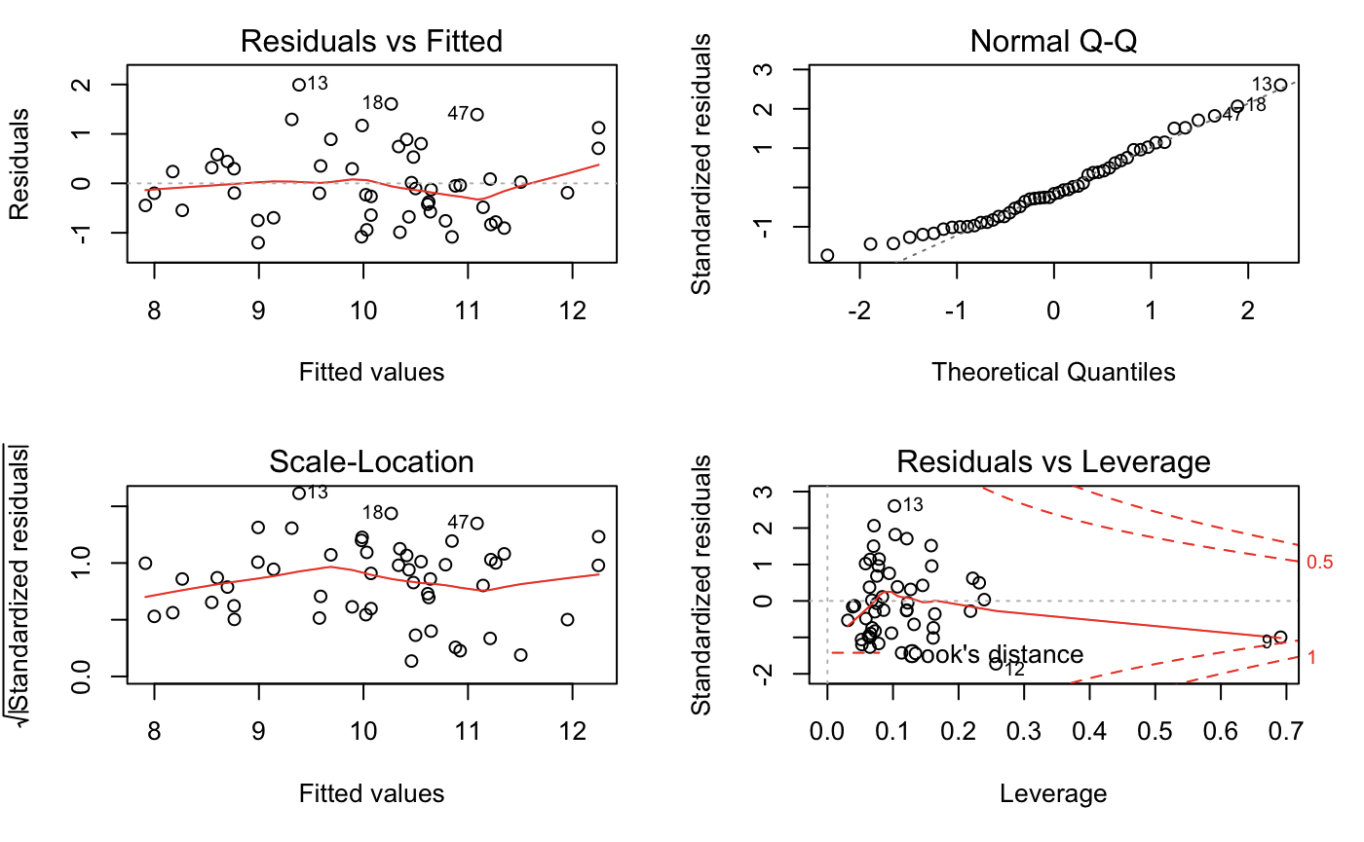
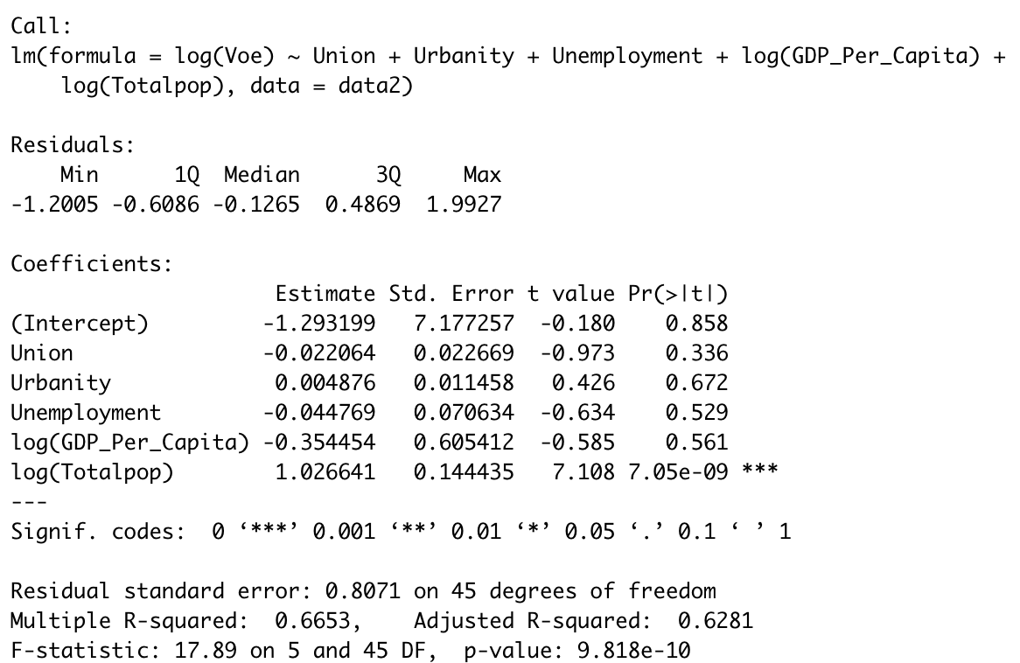
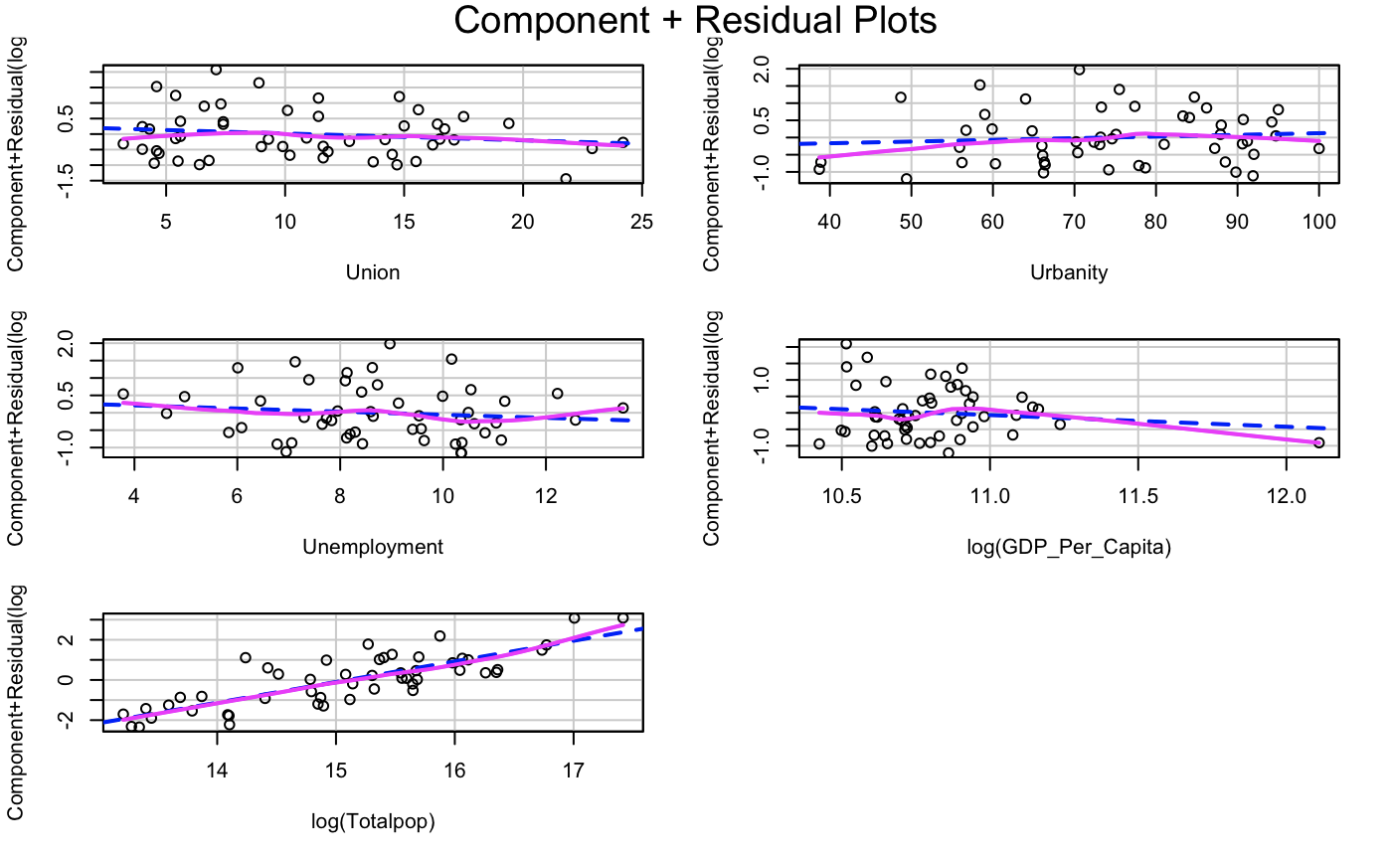
Model2: Transformation

Slide 7

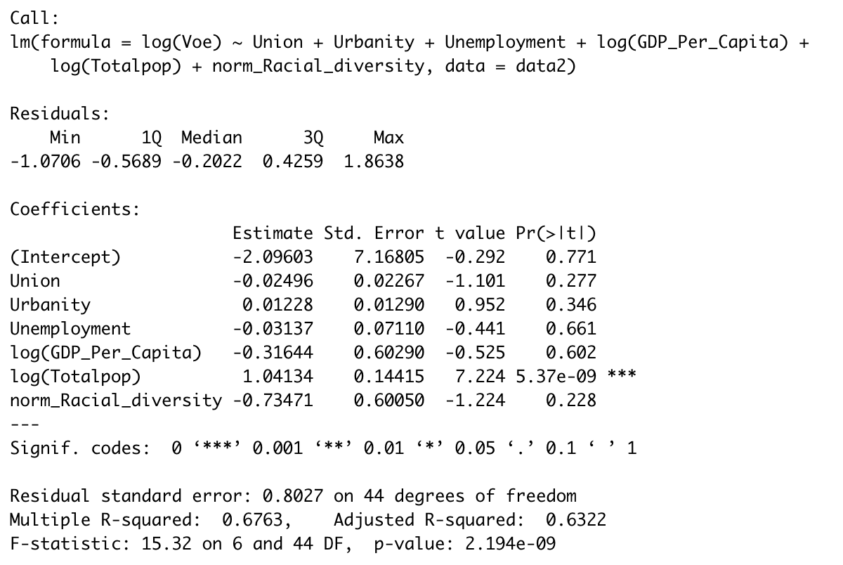
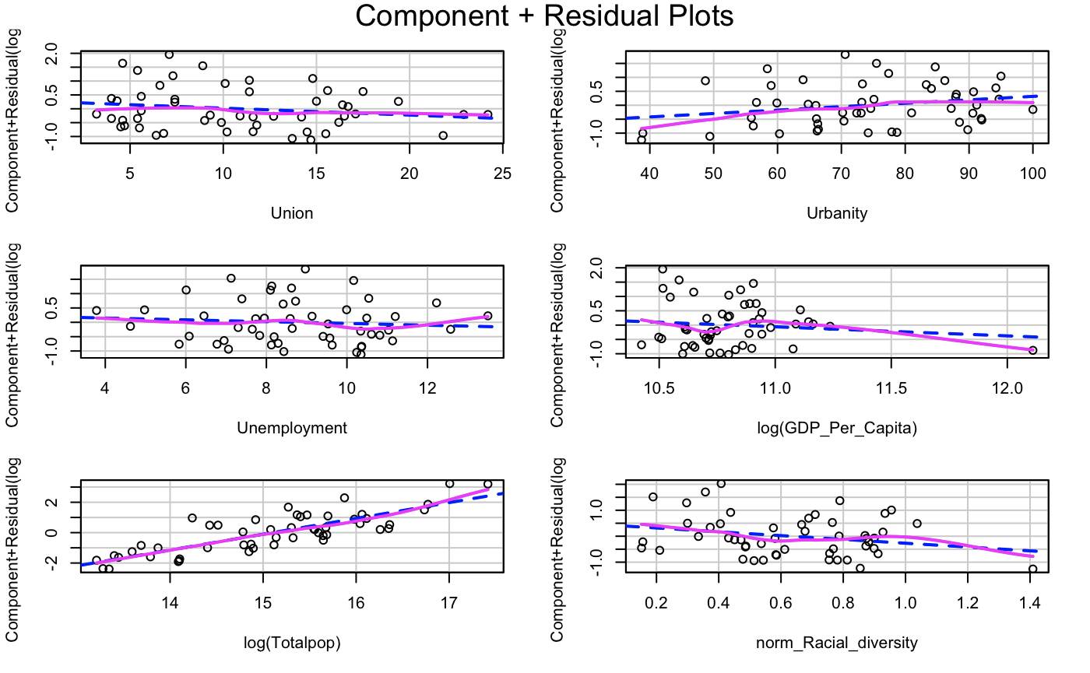
Model3: Model 2 add racial diversity

Slide 8
Mediation Analysis
Mediation Analysis:
A mediation model proposes that the independent variable influences the mediator variable, which in turn influences the dependent variable.
Assumption:
We assume we do not have unmeasured confounding variables.
Rsource:
https://dspace.mit.edu/bitstream/handle/1721.1/91154/Tingley-2014-mediation.pdf?sequence=1&isAllowed=y
Racial Diversity
(Mediator)
Union Density
(Treatment)
Vocational Education
(Outcome)
Notes:
https://dspace.mit.edu/bitstream/handle/1721.1/91154/Tingley-2014-mediation.pdf?sequence=1&isAllowed=y

Slide 9
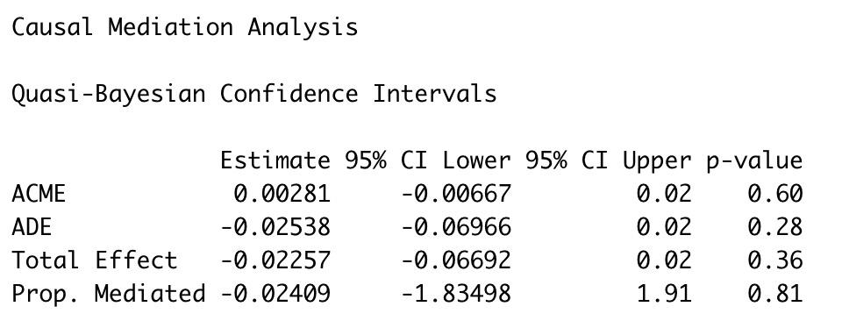
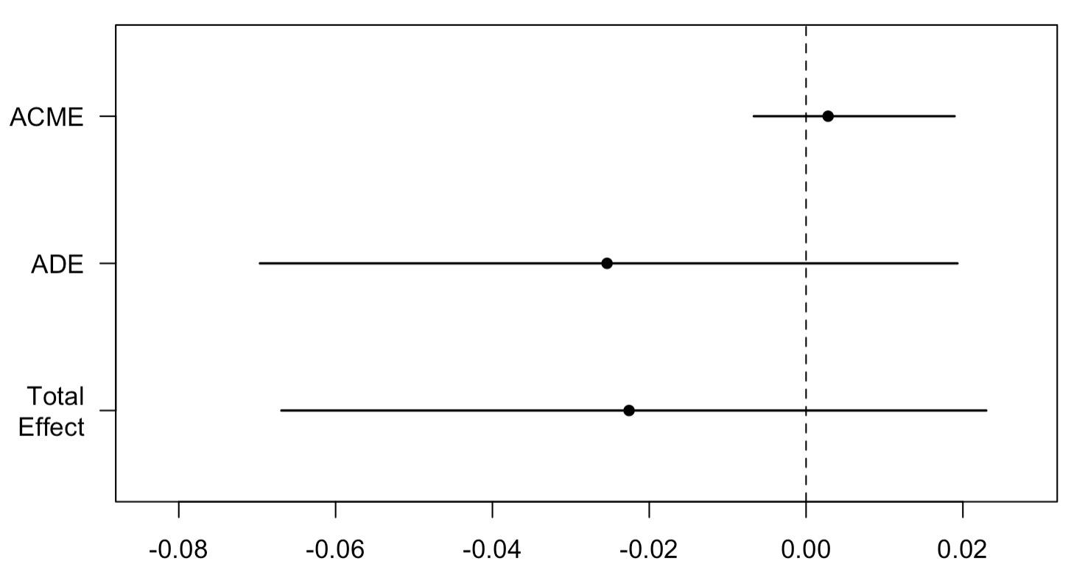
Mediation Analysis on Model 3
Direct effect: Union density versus Vocational Education
Mediation effect: Union density versus Racial diversity
Results: Mediation effect is around zero.
Notes:
https://dspace.mit.edu/bitstream/handle/1721.1/91154/Tingley-2014-mediation.pdf?sequence=1&isAllowed=y

Slide 10
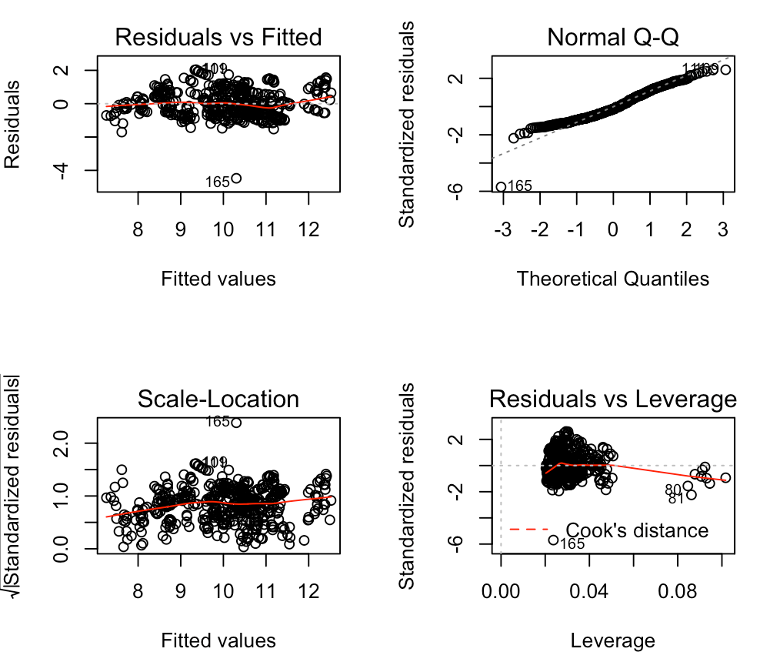
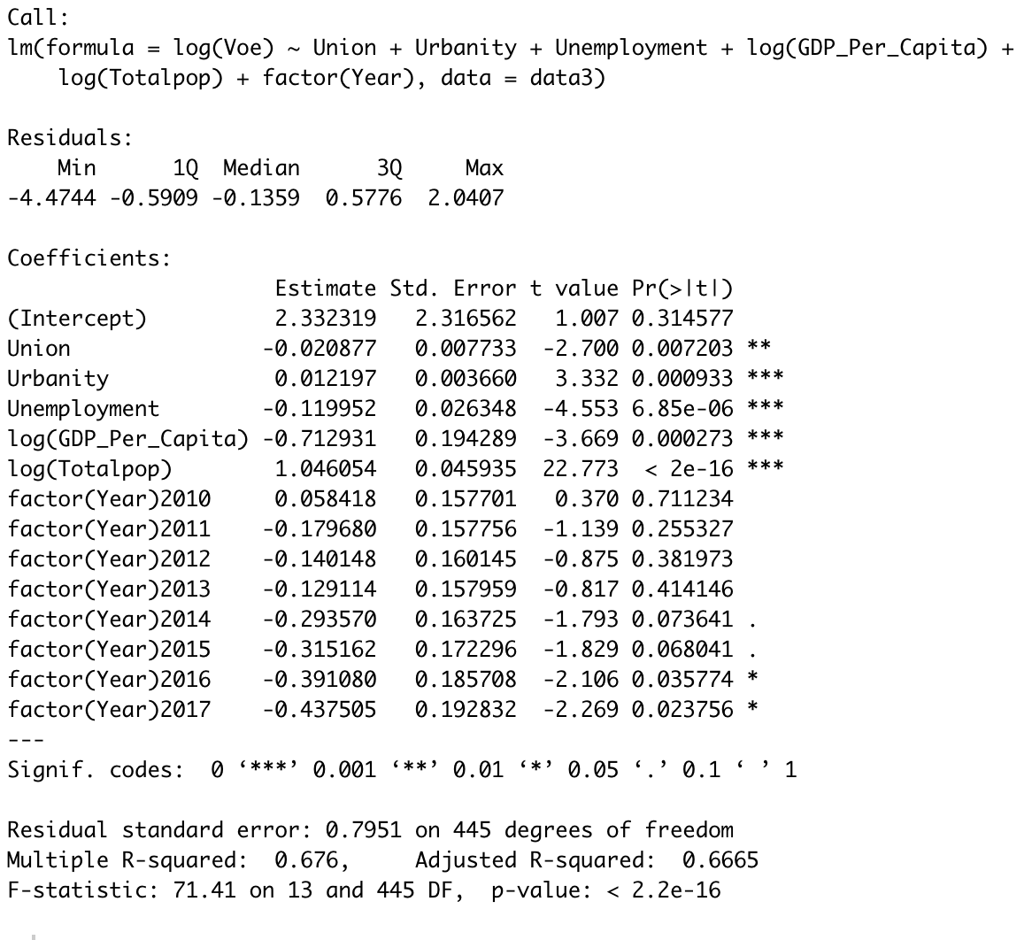
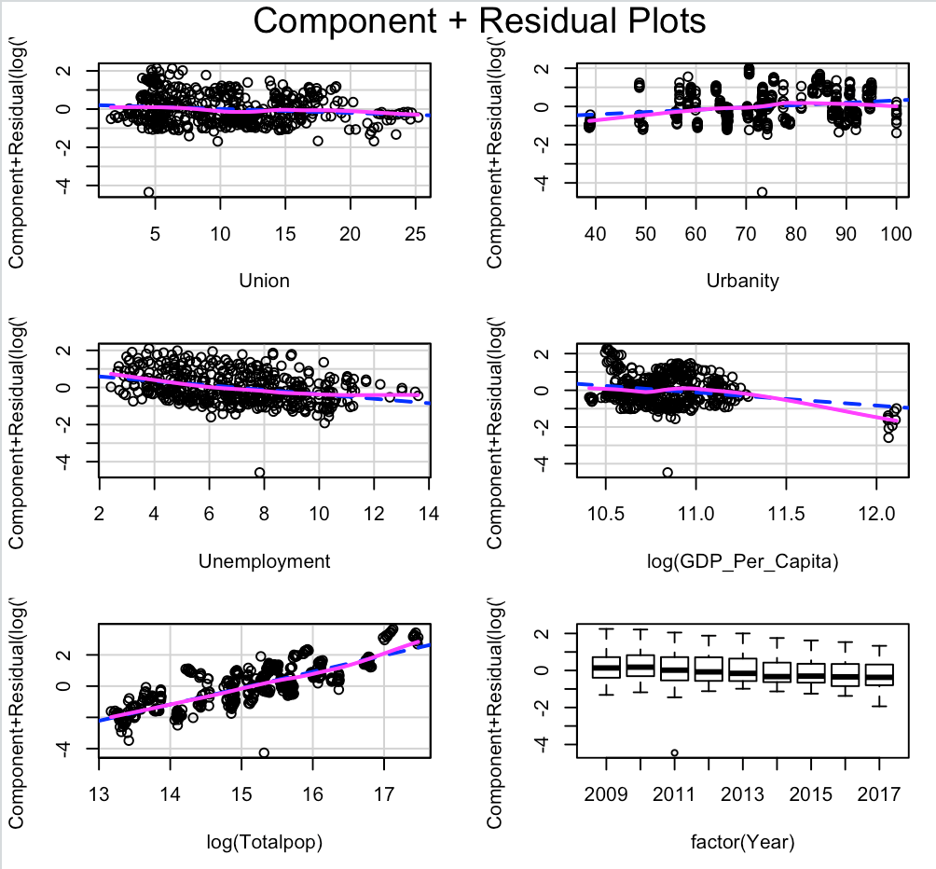
Model4: Transformation

Slide 11
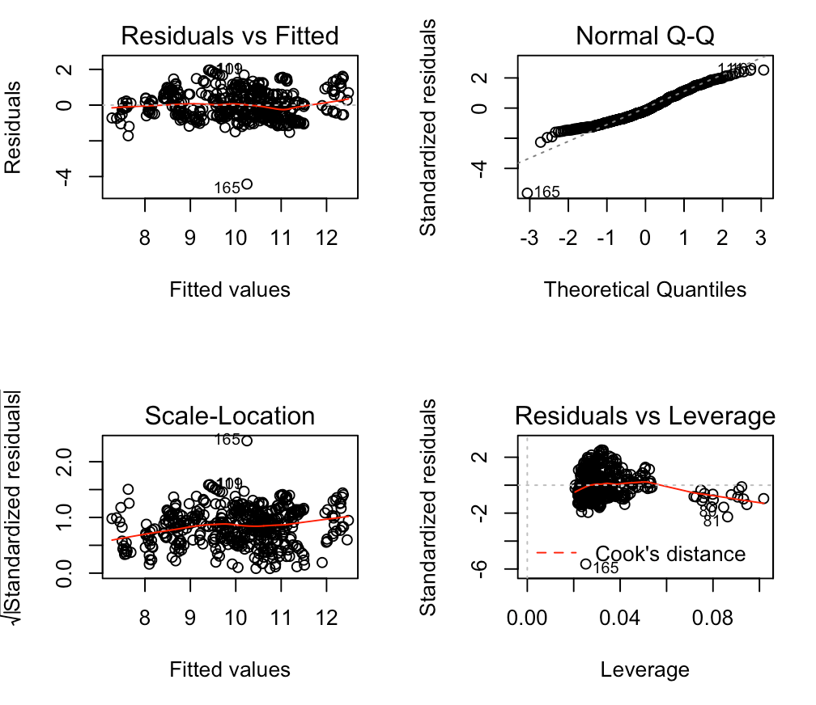
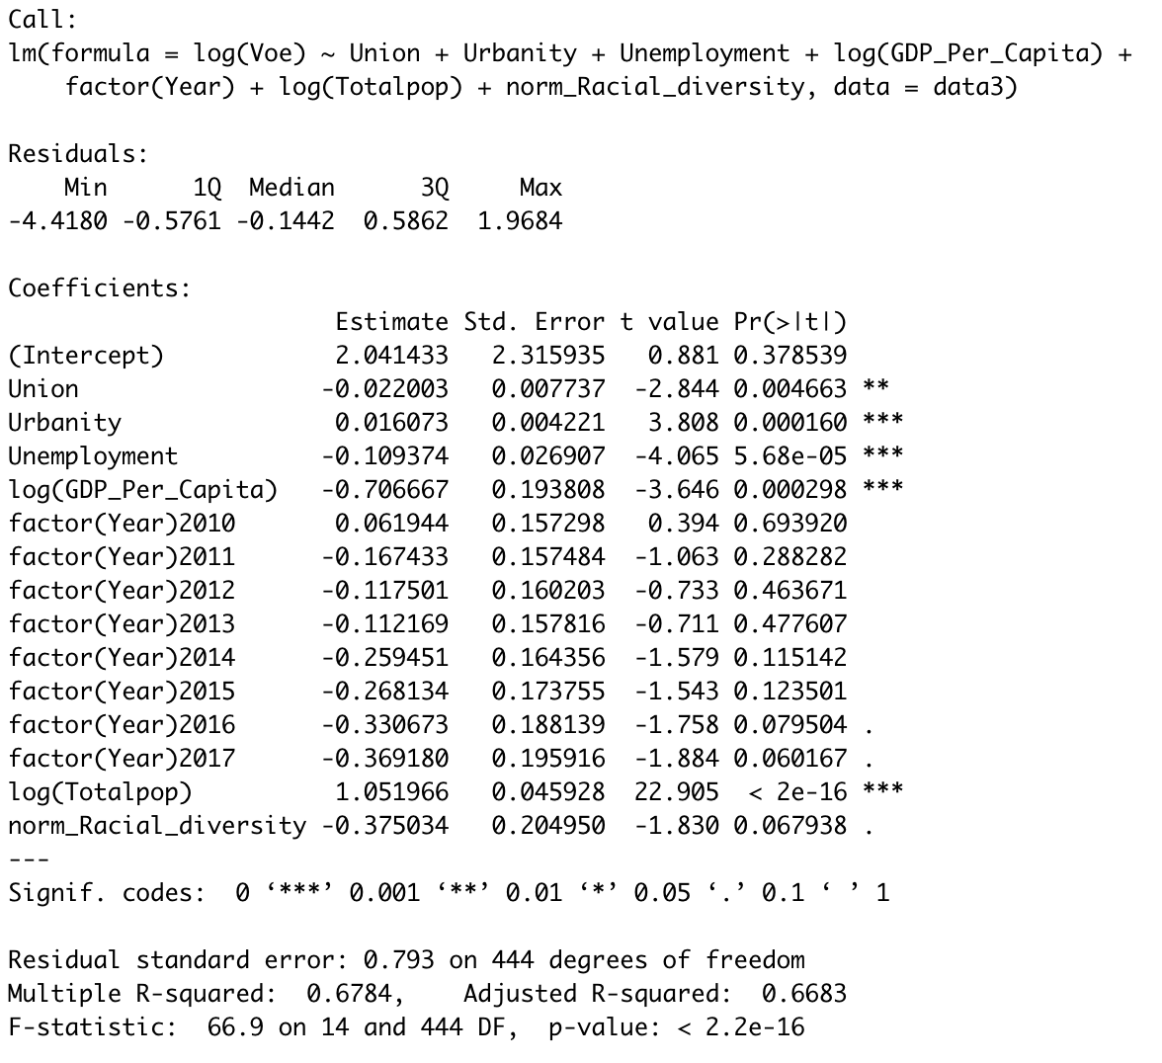
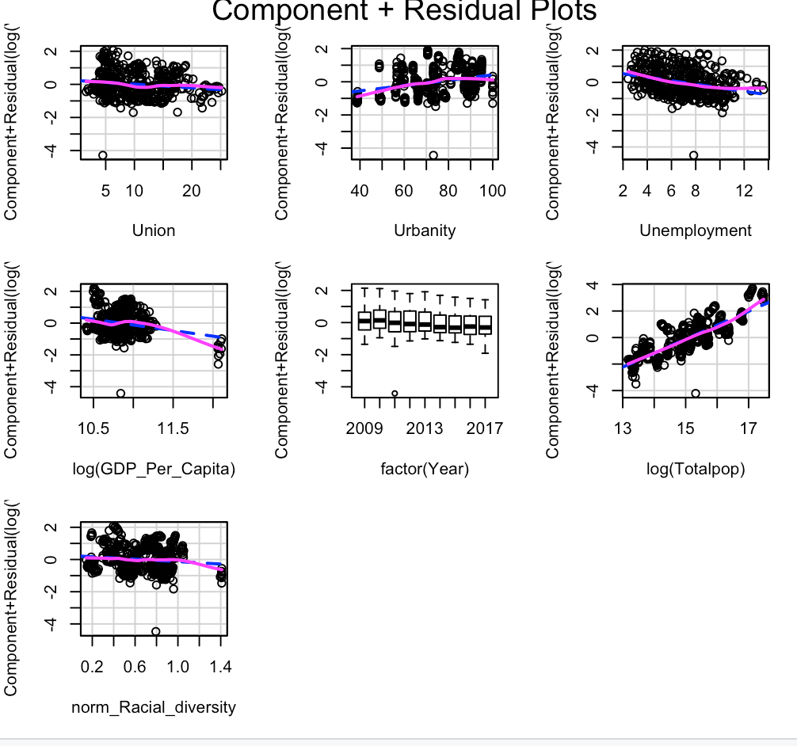
Model 5: Model 4 add racial diversity

Slide 12
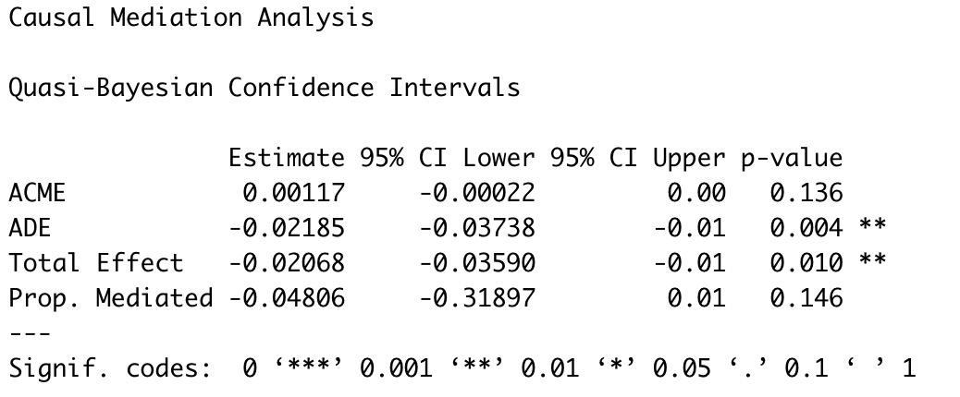
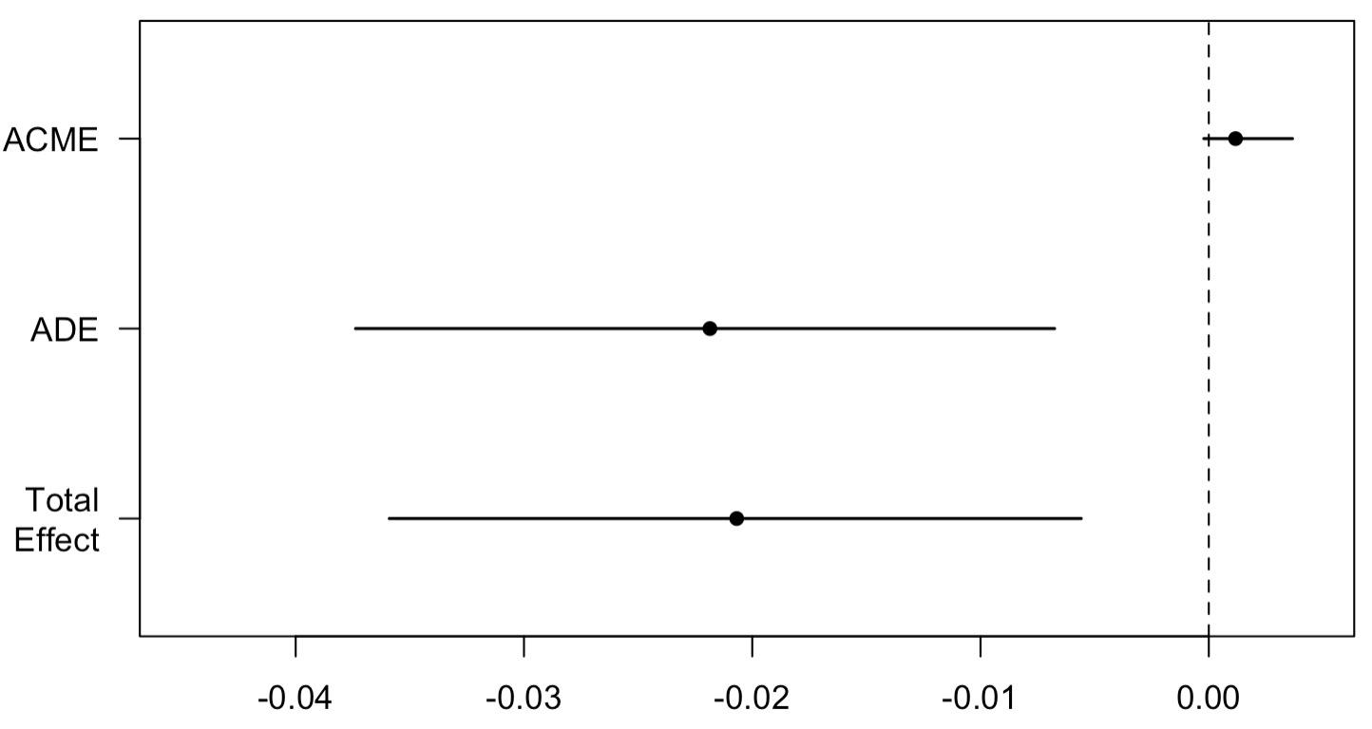
Mediation Analysis
Using data from 2009 to 2017
Direct effect: Union density versus Vocational Education
Mediation effect: Racial Diversity versus Vocational Education
Results: Mediation effect is around zero.
Notes:
2009-2017

Slide 13
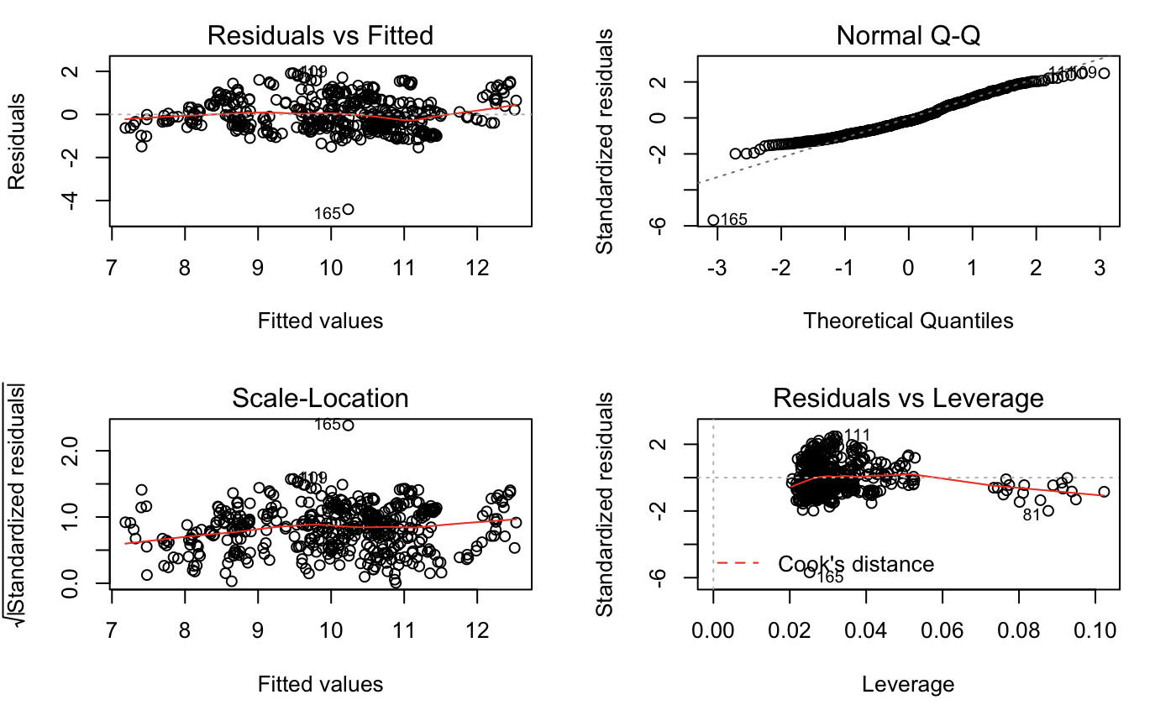
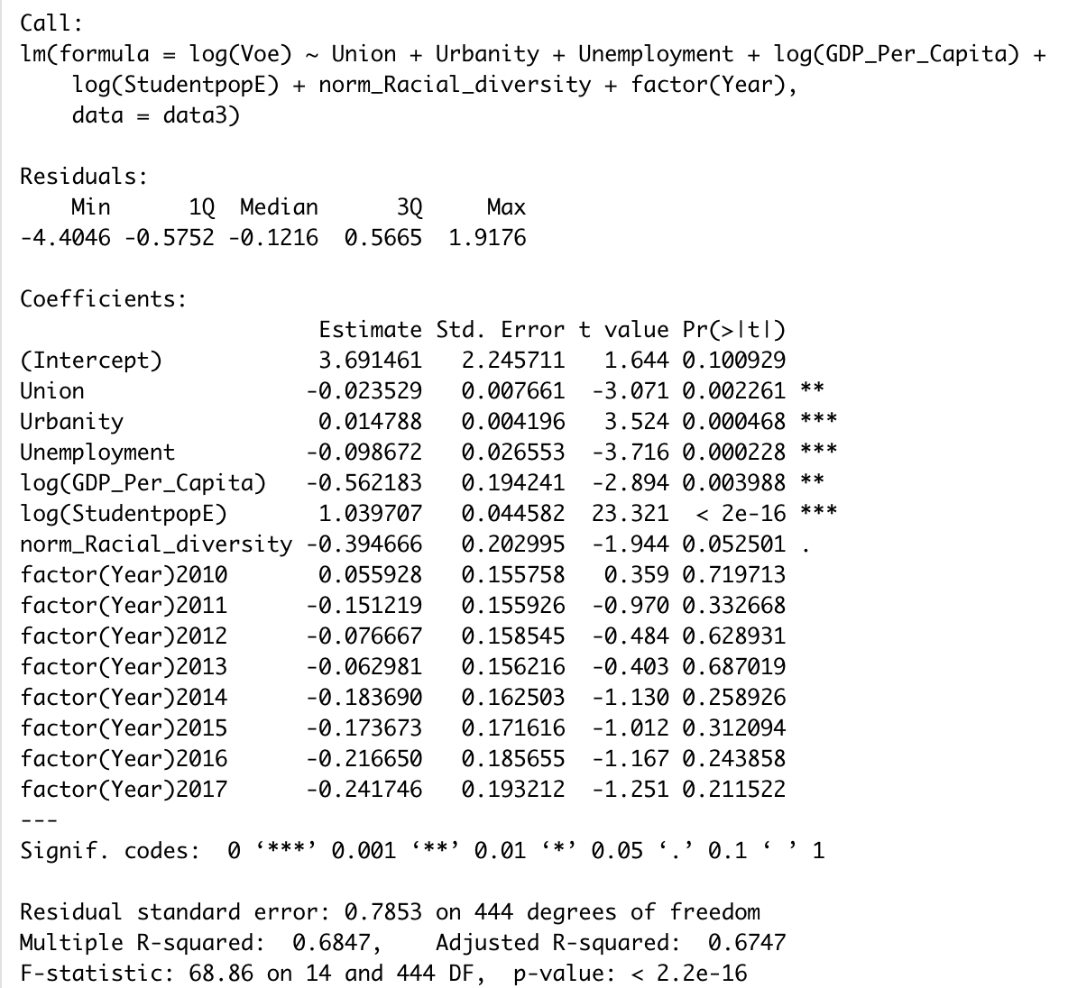
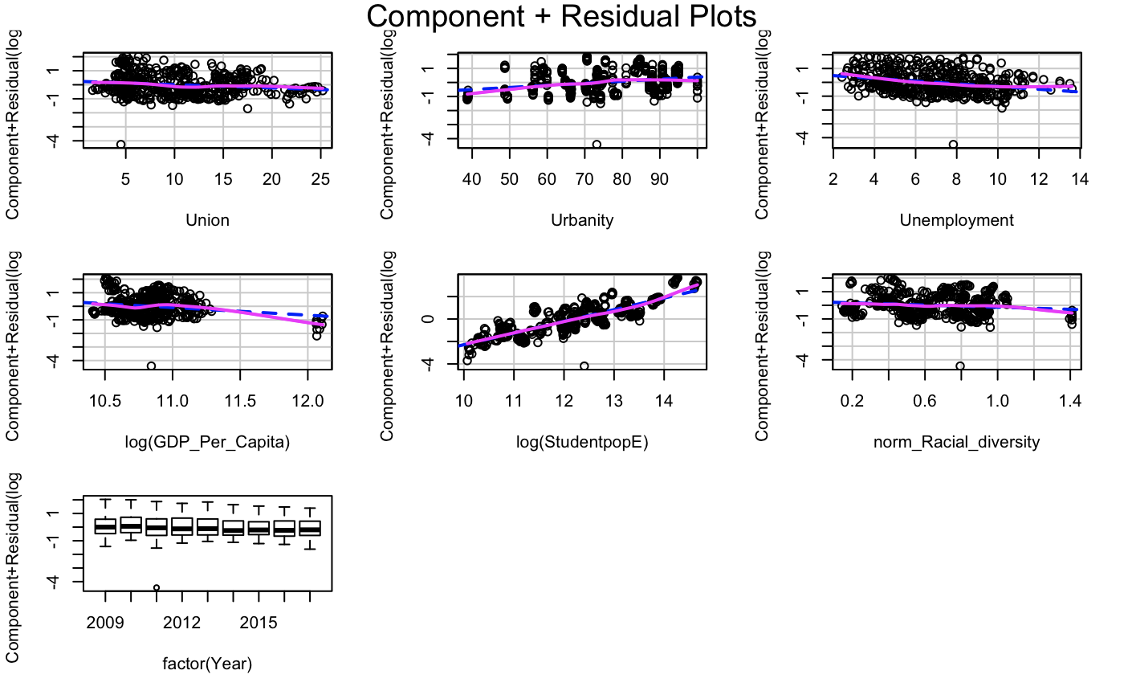
Model 6: Student Pop + Racial

Slide 14
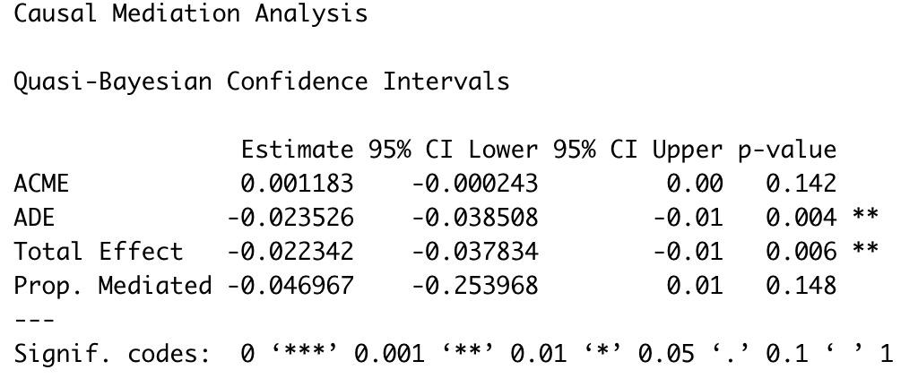
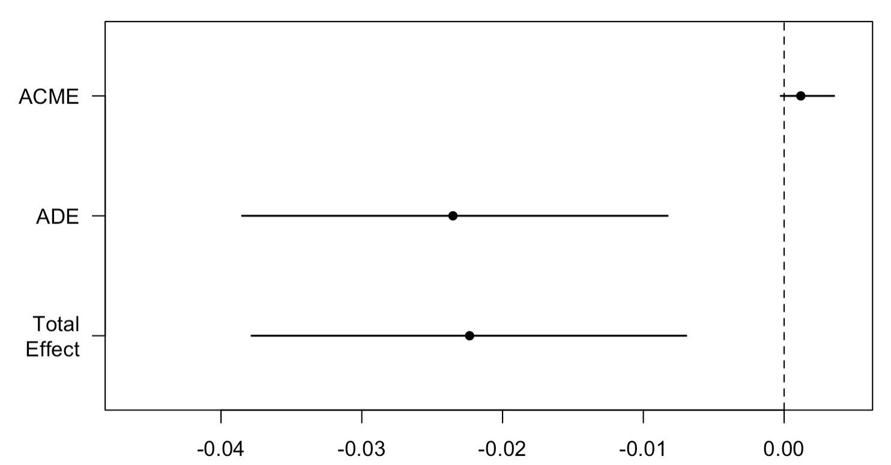
Mediation Analysis
Using “student population” rather than “total population”
Direct effect: Union density versus Vocational Education
Mediation effect: Racial Diversity versus Vocational Education
Results: Mediation effect is around zero.

Slide 15
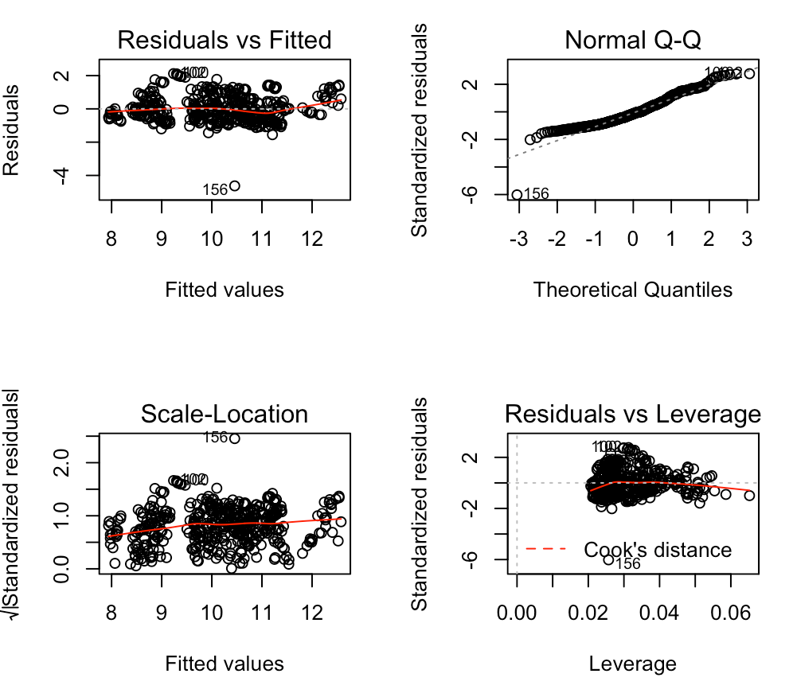
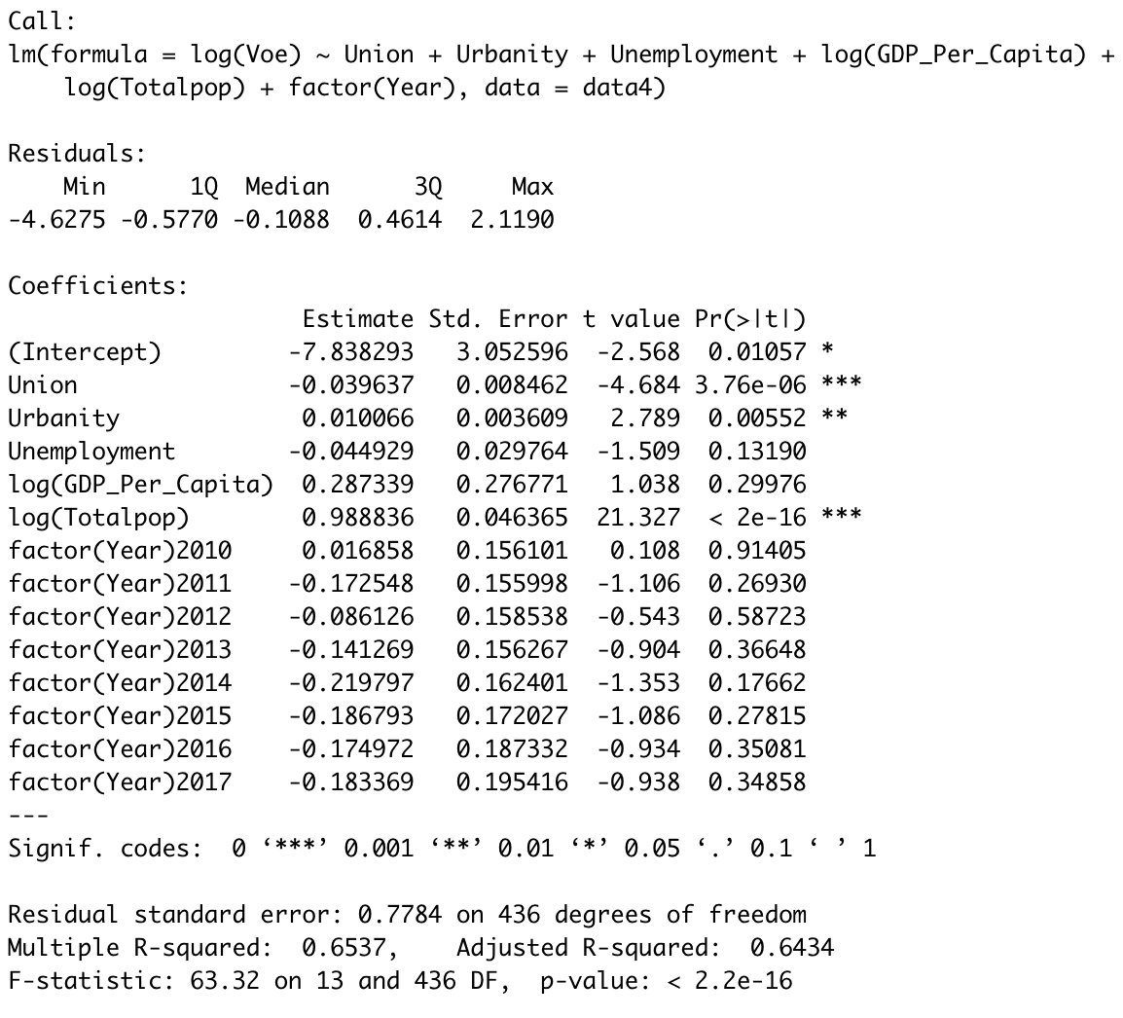
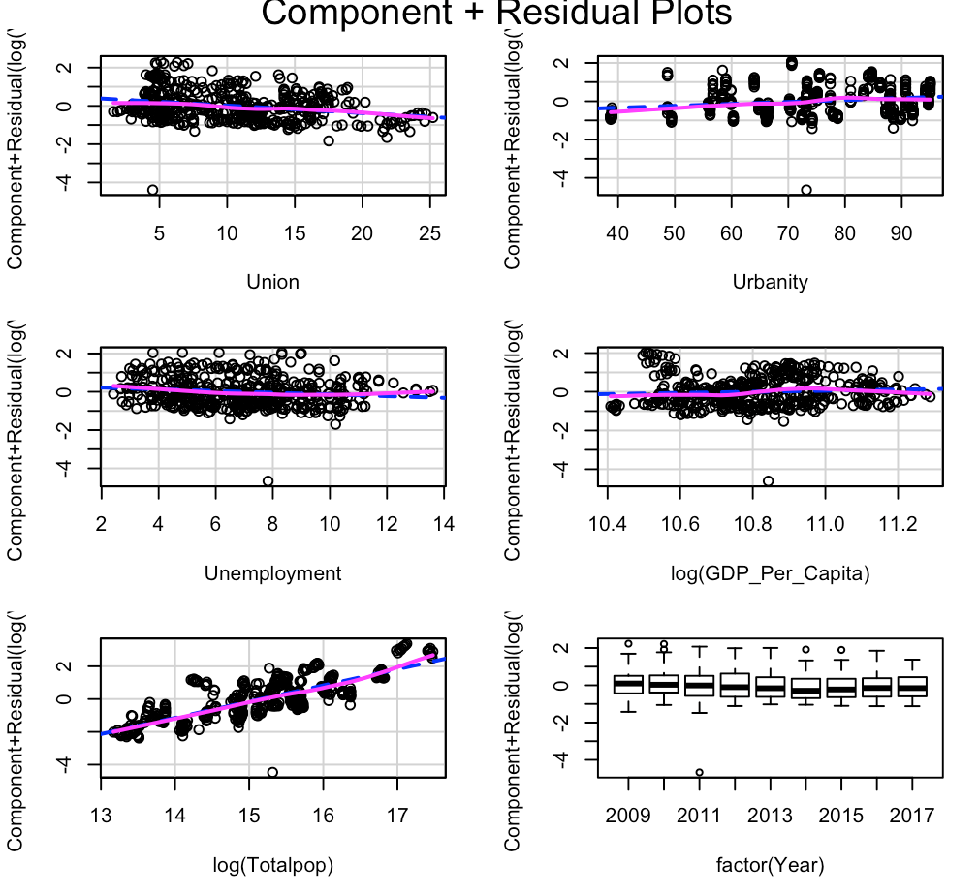
Model 7: Exclude DC

Slide 16
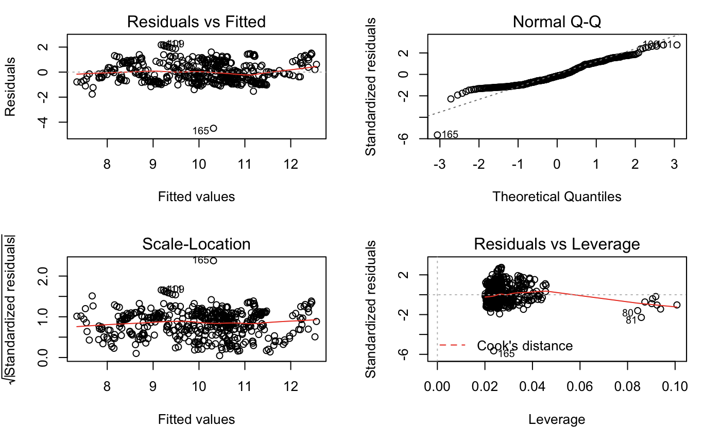
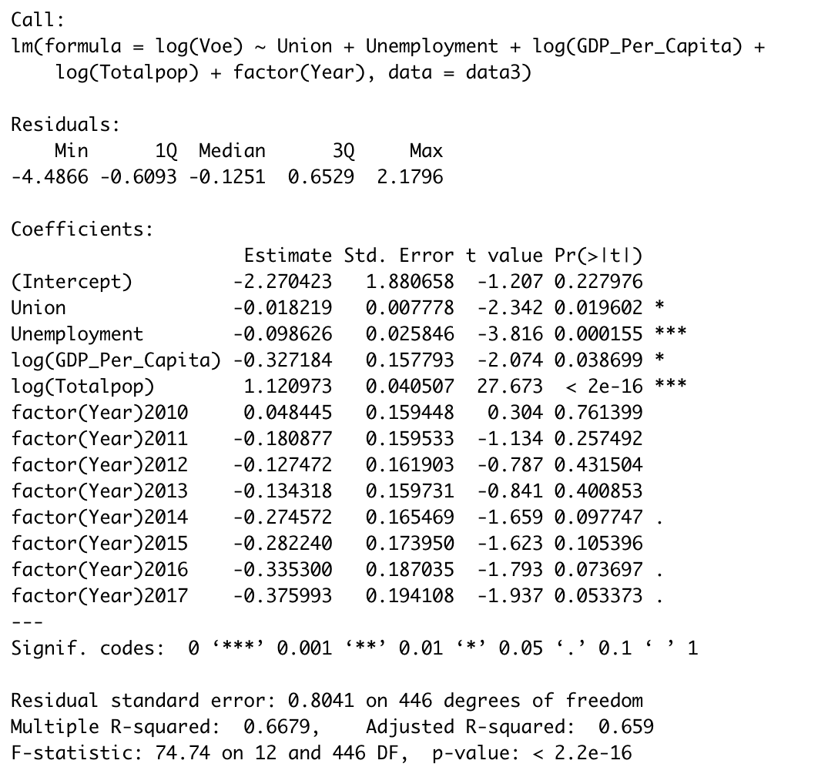
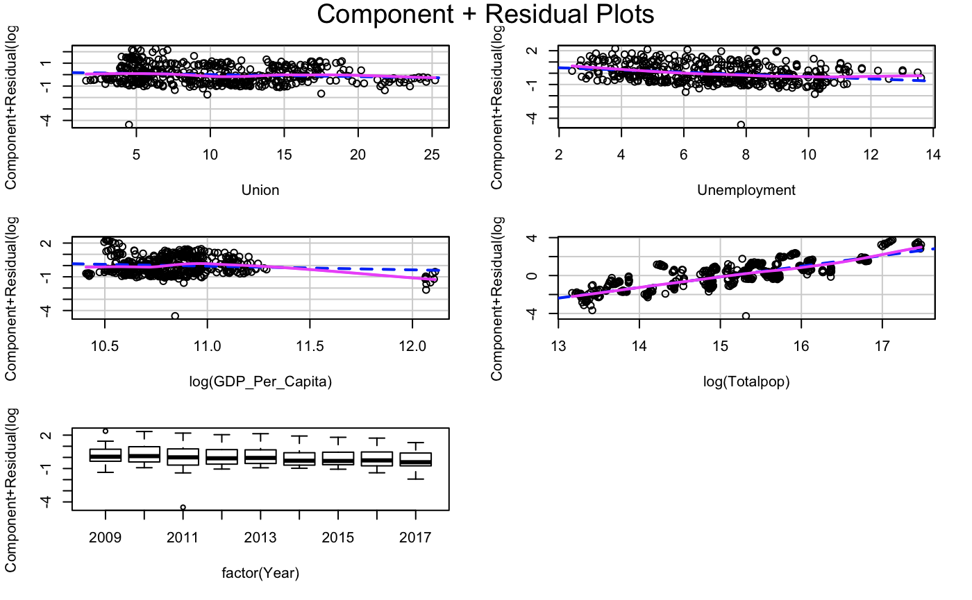
Model 8: Drop the urbanity

Slide 17
Conclusion
For the analysis we did, we do not have evidence to conclude that racial diversity explains the relationship between vocational training and union density because the mediation effect is nearly zero.
Those results are based on the assumptions that we do not have other unmeasured variables.

